Slide 1


User Research: David Bae
Interaction Design: Zhoujun Ying
UI Design: Helen Sun
UX Research: Philip Lan
UX Analyst: Adriana Ramirez
UX Design: Daokai Lin
ReVital
Solution to your fatigue
By Team Sleepless

Slide 2
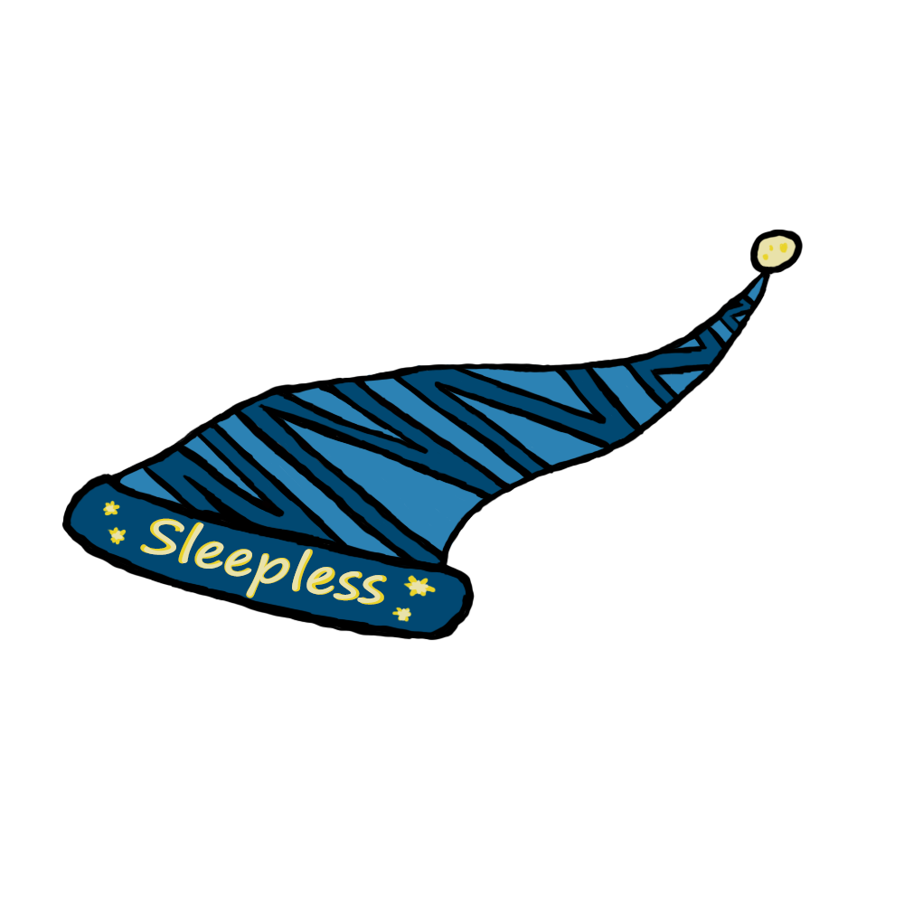

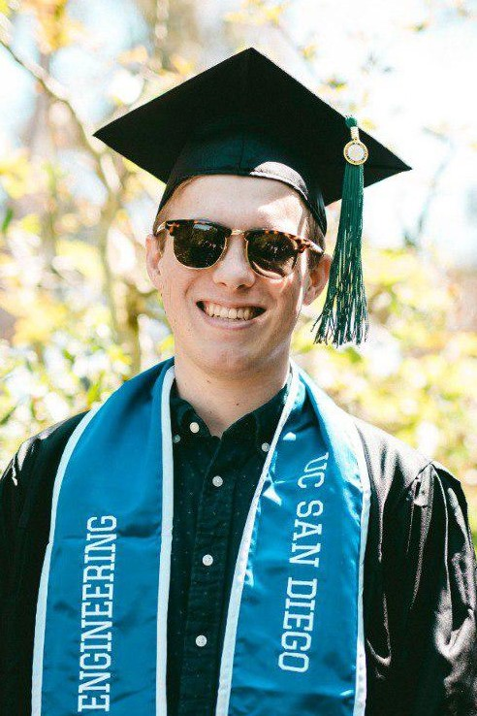

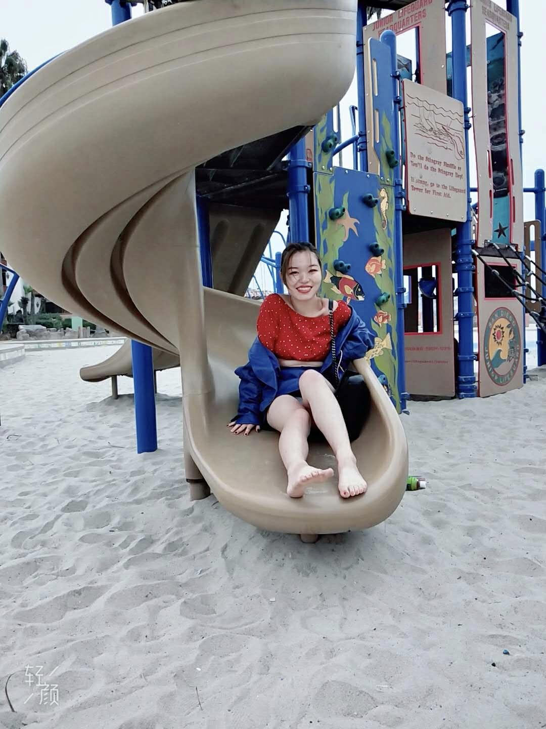

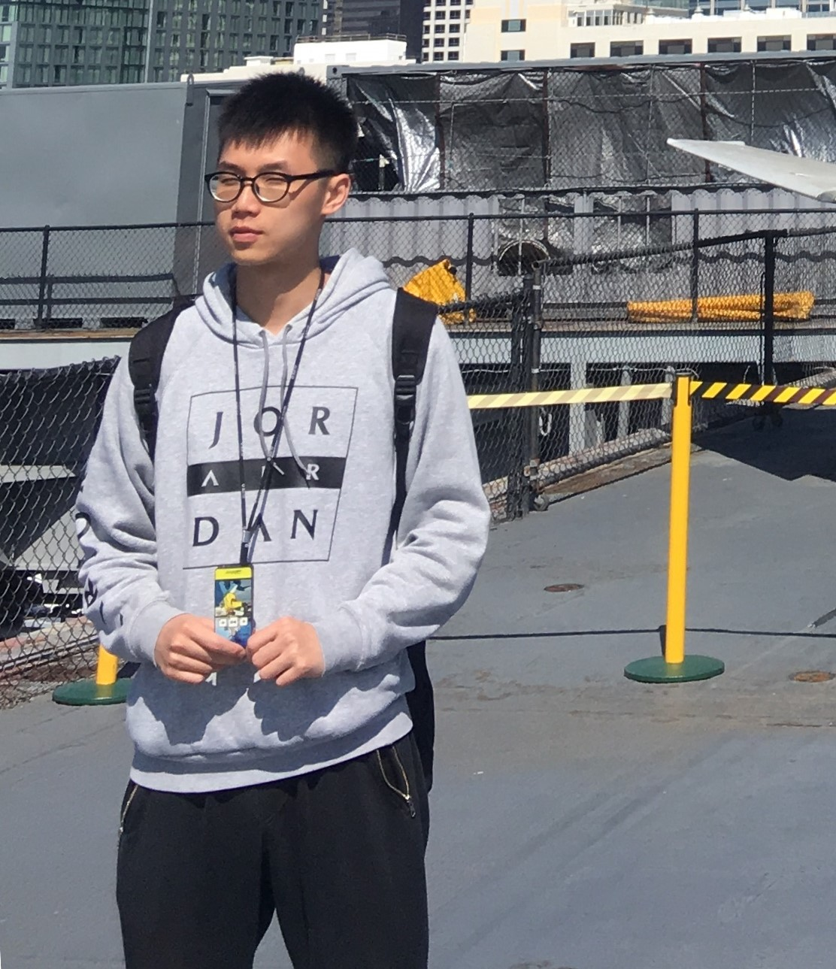
Sleepless Awakens
David Bae
Ian Philipp
Yuanjun Sun
Zhuojun Ying
Adriana Ramirez
Daokai Lin
Notes:
-Assign roles to everyone
-

Slide 3

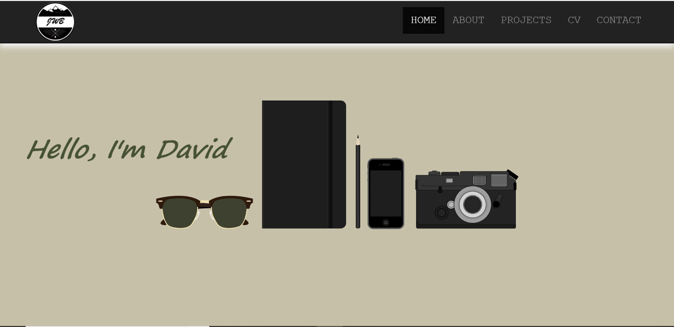
David Bae
Role: User Research

Slide 4

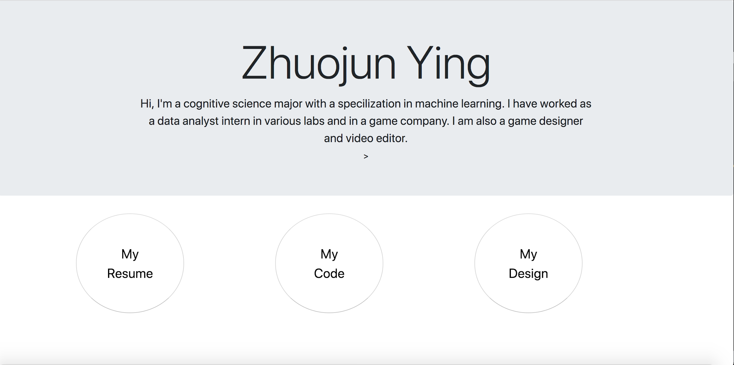
Zhuojun Ying
Interaction Designer
portfolio link: z5ying.github.io
Notes:
Members personal info here

Slide 5
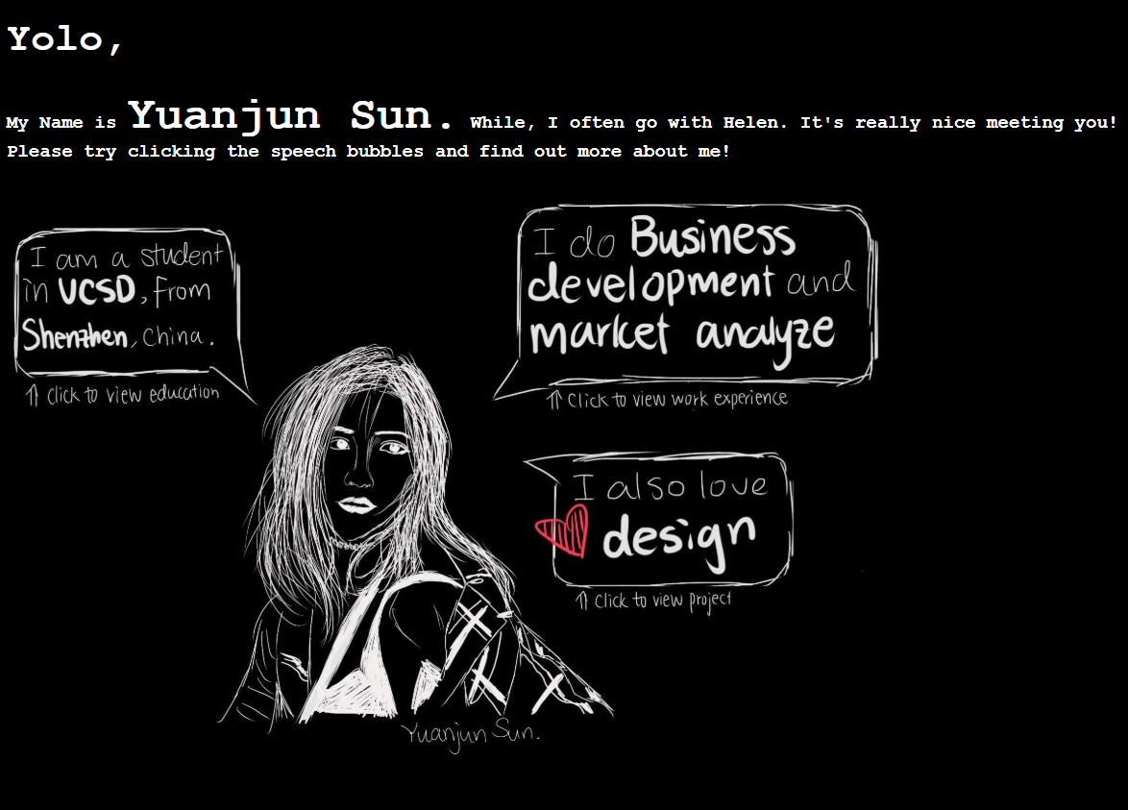

Yuanjun (Helen) Sun
UI Artist, Photographer
Notes:
Members personal info here

Slide 6

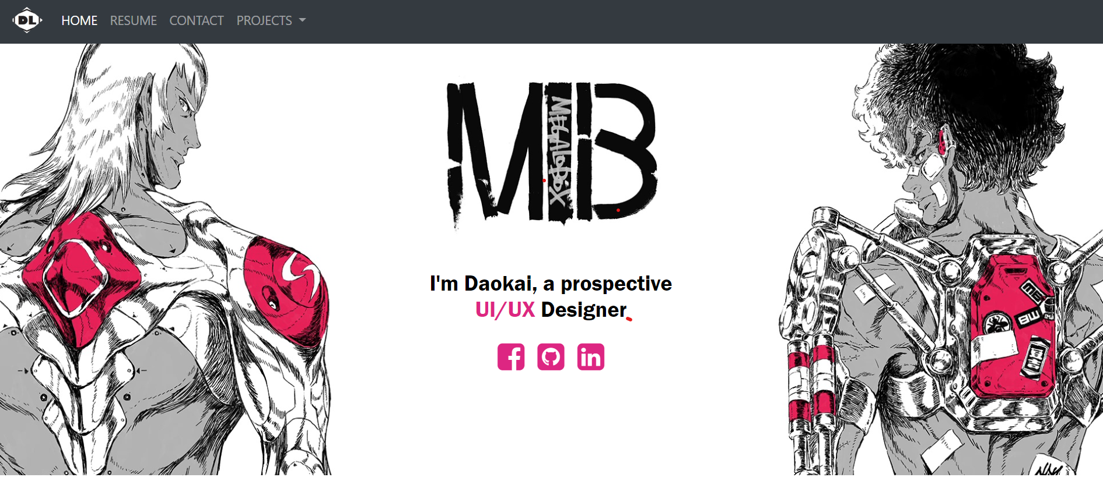
Daokai Lin
Link: https://daokailin.github.io/#
UX Analyst
Notes:
Members personal info here

Slide 7

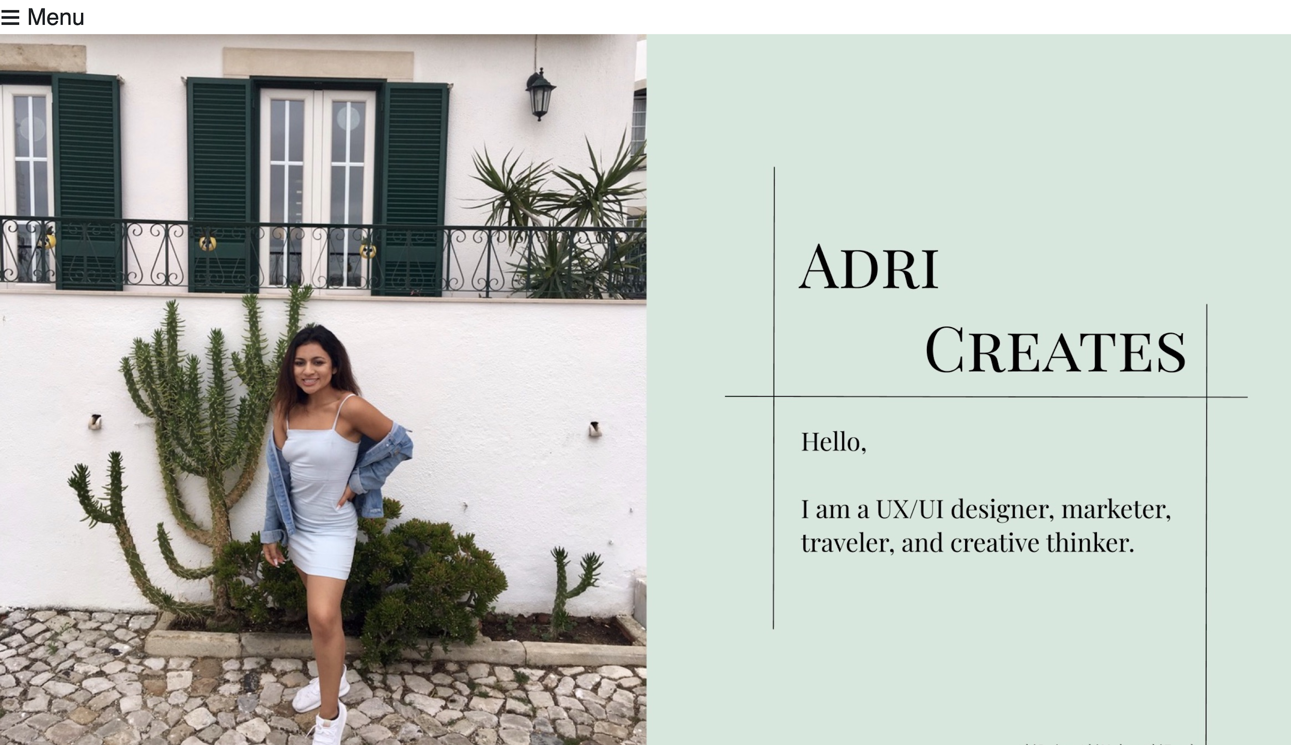
Adriana Ramirez
UX Analyst
Notes:
Add logo and picture

Slide 8
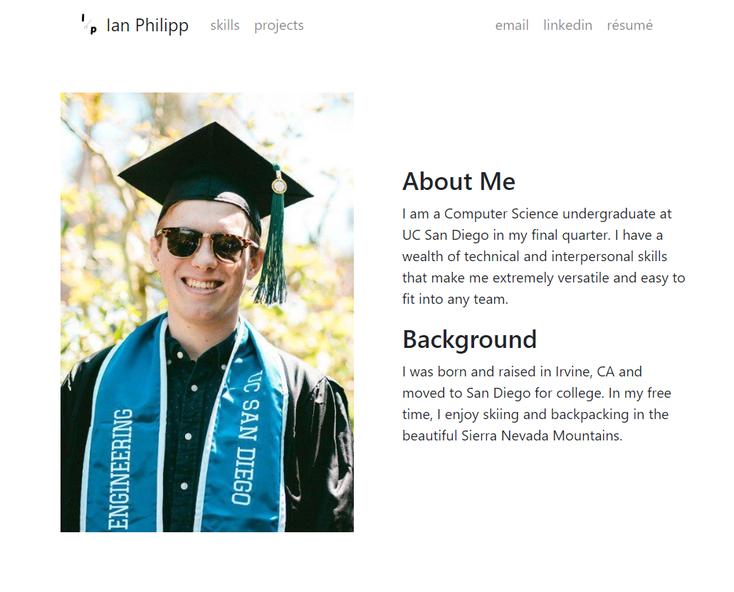
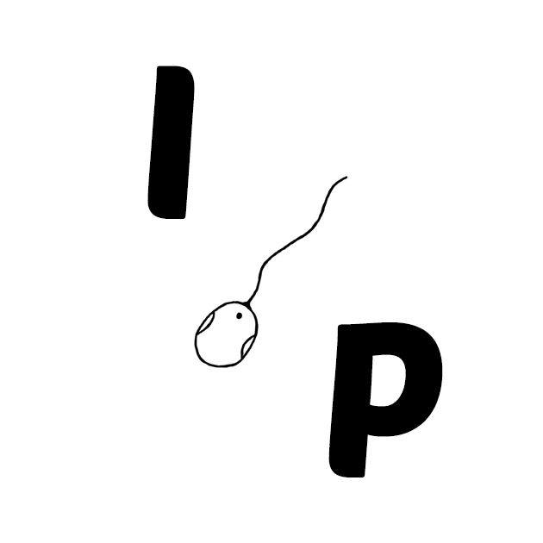
Ian Philipp
UX Designer
Notes:
Members personal info here

Slide 9
The Problem...
Fatigue
Notes:
David

Slide 10
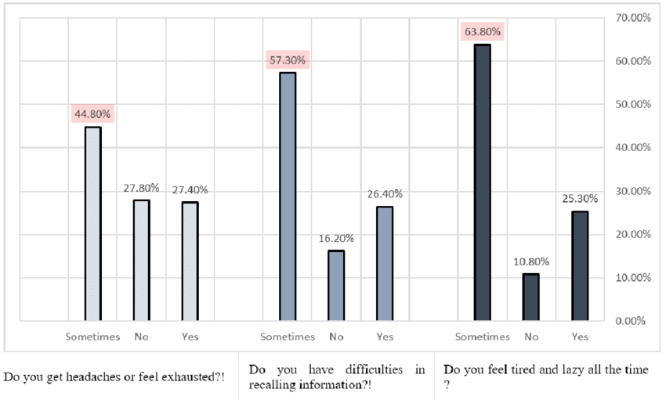
The Stats
62% of night shift workers complain about sleep loss
87% of students in high school and above get too little sleep
63.7% of college students say they feel fatigued at least 3 days a week.
More than 43% of workers are sleep deprived.
Notes:
David
Stats from National Safety Council and Research Gate

Slide 11
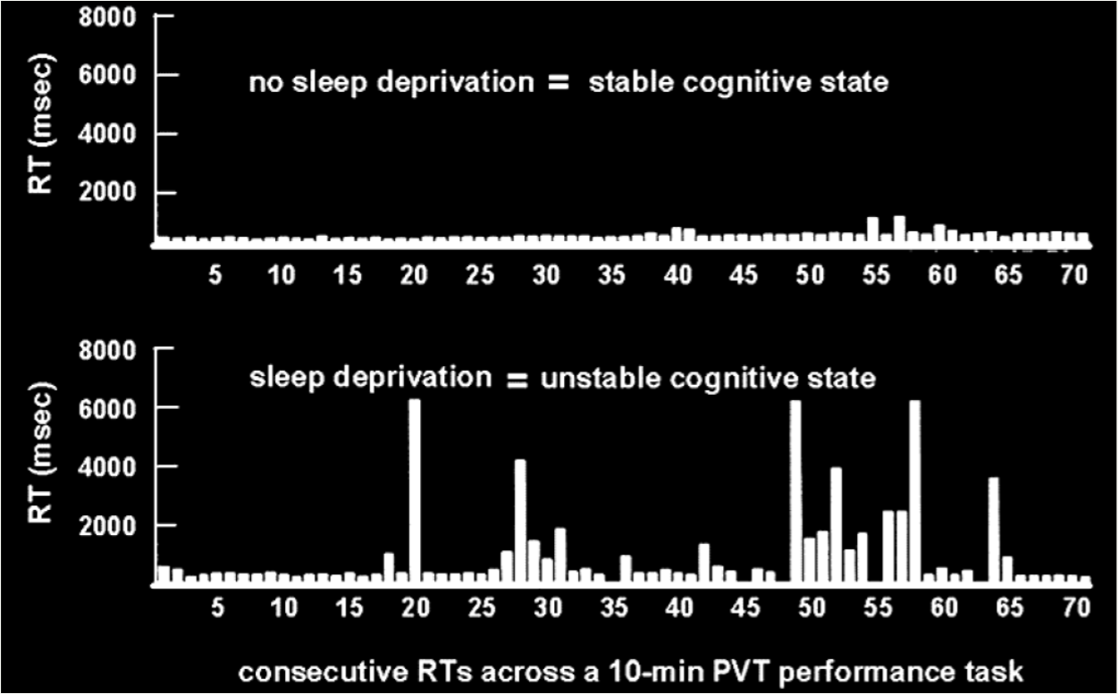
The Impact
Staying awake for at least 18 hours is equivalent to having a BAC of 0.05%
Fatigue is estimated to cost employers $136 billion a year in health-related lost productivity.
Studies show strong correlation between sleep quality and GPA.
RT = Reaction time
PVT = Psychomotor Vigilance Task
Notes:
David
(BAC level of 0.08% is considered legally drunk)
BAC = blood alcohol concentration

Slide 12
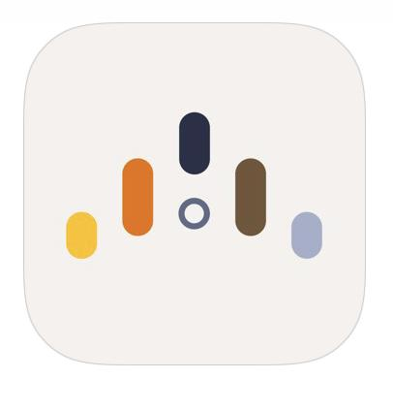
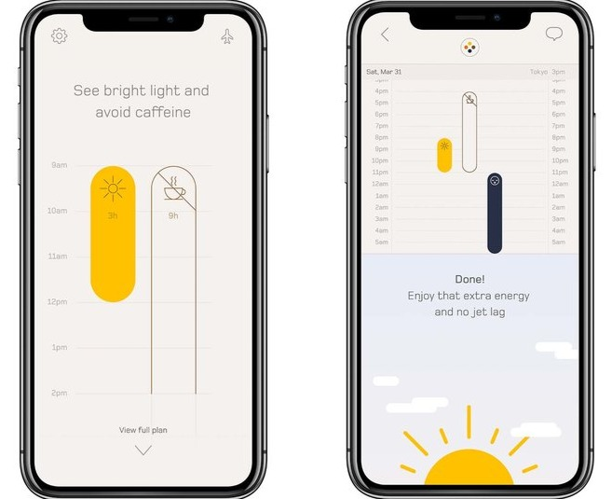
Timeshifter
PROS
Exclusively designed for business travelers
Informs you when to take coffee, melatonin, & when to sleep
CONS
Not customizable to user who is using the app
Only focuses on the symptoms of jetlag
Notes:
-Tracks the sleeping pattern of user
-Generate patterns as well as create goals for better sleeping habits

Slide 13
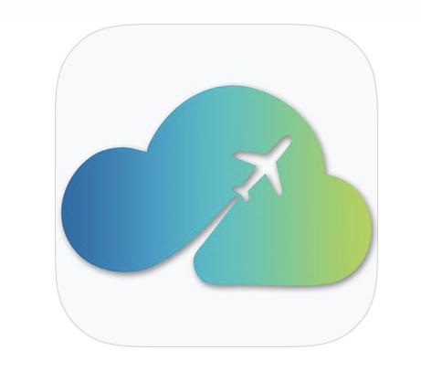
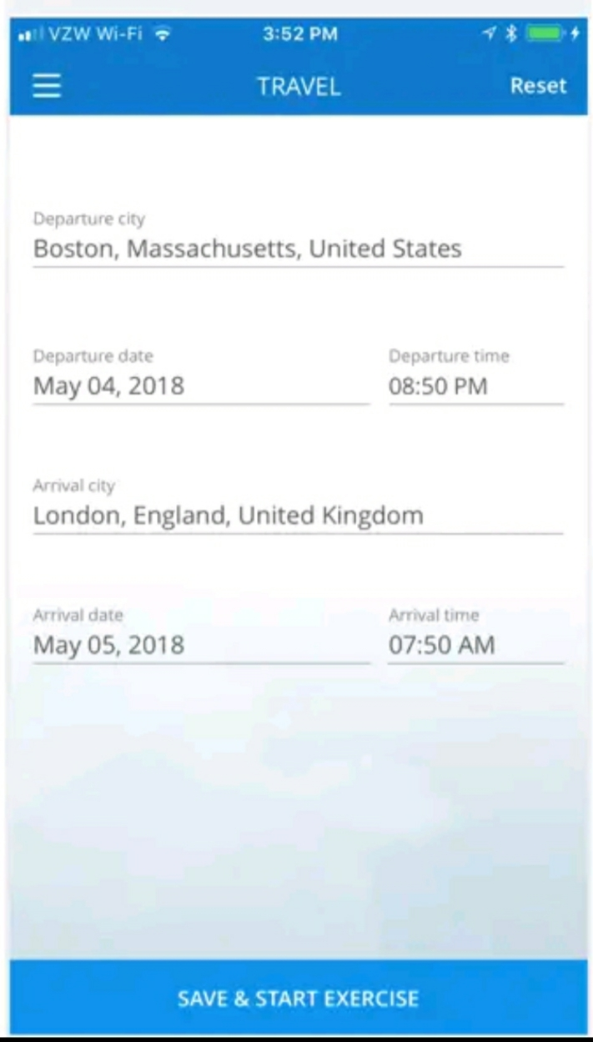
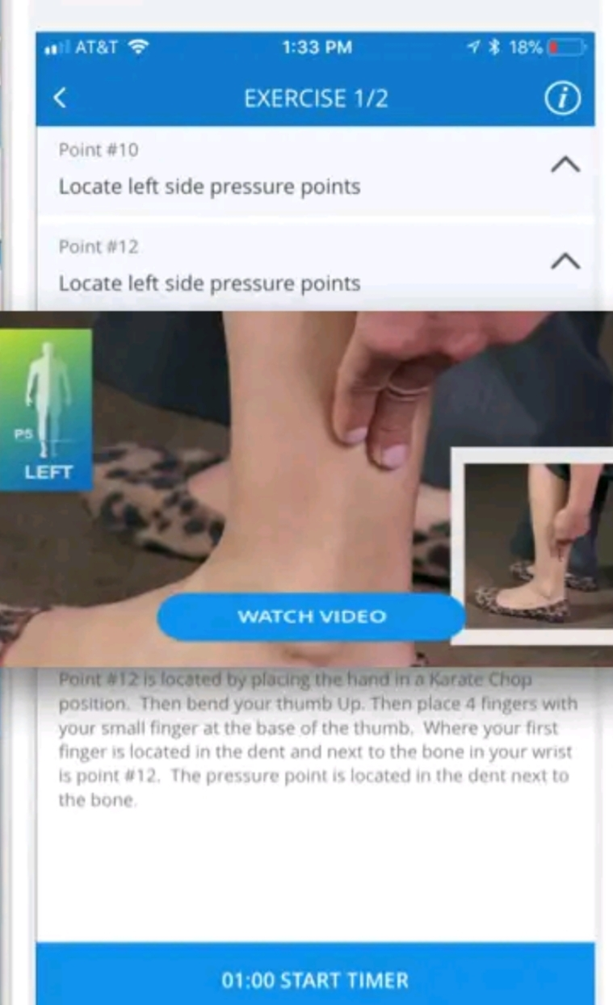
Uplift
PROS
Provides all kinds of solutions, like exercise
Have videos that illustrates how to do the exercise
Can enter flight itinerary
CONS
This is only for Jet Lag
The result is not customized to individual, but more a general plan
Notes:
-Tracks the sleeping pattern of user
-Generate patterns as well as create goals for better sleeping habits

Slide 14
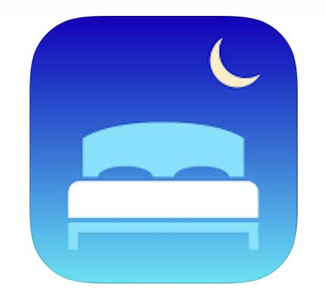
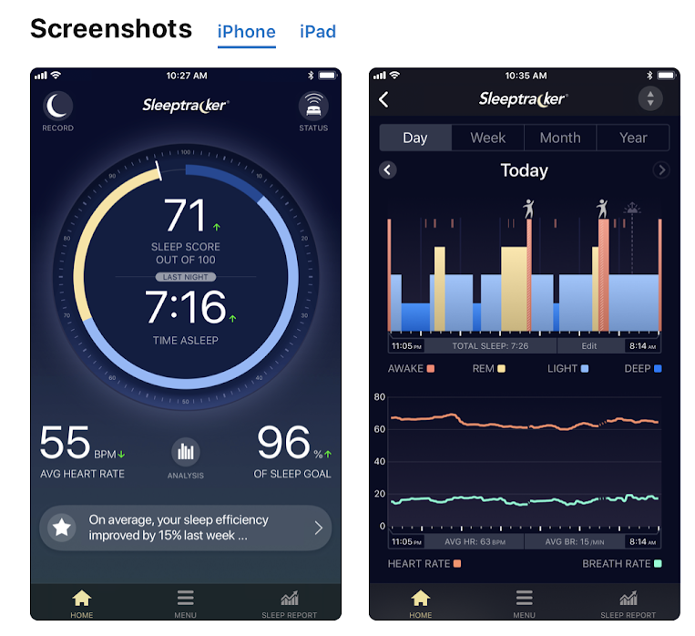
Sleeptracker
PROS
Tracks the sleeping pattern of user
Generates sleeping patterns of the user daily, weekly, monthly, and yearly
CONS
Only tracks and provides generic advice
Has to have a “smart bed” to be provided a more accurate tracking pattern
Notes:
Our third competitor is sleep tracker who is the average the sleeping tracking app that generates the ones sleeping patterns and it will give the user some generic advice

Slide 15


Competitor Feature Comparison
Addresses some sort of chronic fatigue
Customized specifically for user with personal data
Creates a plan for user different cases of chronic fatigue
Notes:
Here we have a table showcasing all our competitors along with some key features. All of the apps address chronic fatigue in some sort of way. However the MAIN difference between Revital and all of its competitors is that revital uses our user’s personal data to make a customizable plan for many chronic fatigue situations

Slide 16
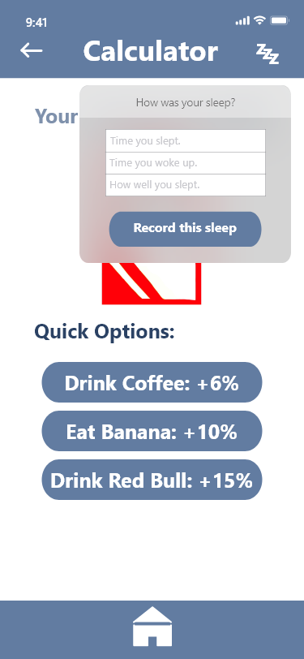
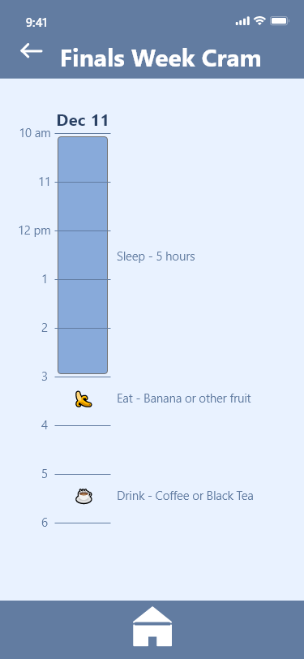
ReVital
Why are we special:
Uses quick options to maximize your
productivity
Requires minimum data input
our app looks at chronic fatigue as a whole
What the app can do:
Creates customizable study plans
Calculates your energy levels
Checks your actual cognitive ability
Calculator
Plan
Notes:
The Revital app creates customizable plans for you to conquer your chronic fatigue using face scanners, fingerprint scanners, and strategies of neuroscience. Through the collection of data within the app, Revital will calculate a plan that will help you to obtain maximum energy levels using various techniques like when to take melatonin, or how much caffeine you need during study session. In addition to these, it can also check your actual cognitive ability based on memory and reflex games

Slide 17

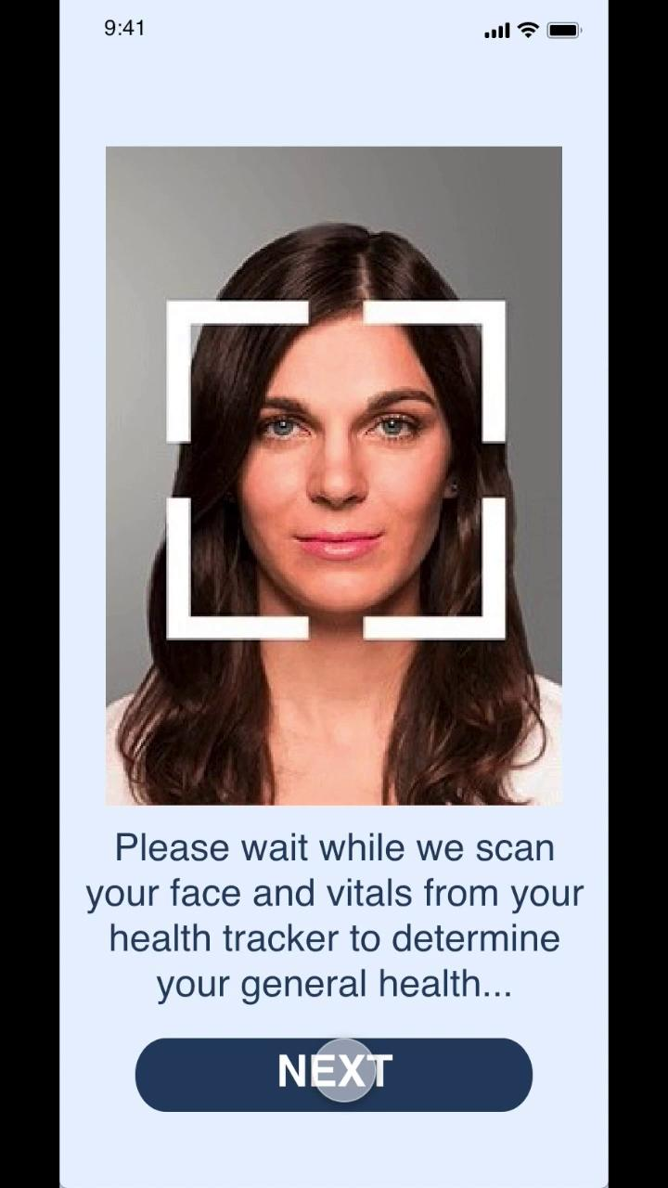
Demo
Notes:
Prototype walk-through here

Slide 18





Design Process
Storyboarding
Prototyping
User Testing
Real-life scenarios when people couldn’t stick to the plan
Calculator : supporting algorithm vs independent function
Energy level is subjective
User-specific contents and alternative plans.
- Calculator: simple prediction for user-generated plan
- Planning: Detailed timeline for app-generated plan
Evaluate cognitive performance through gamification to enhance prediction
Notes:
Ruby

Slide 19
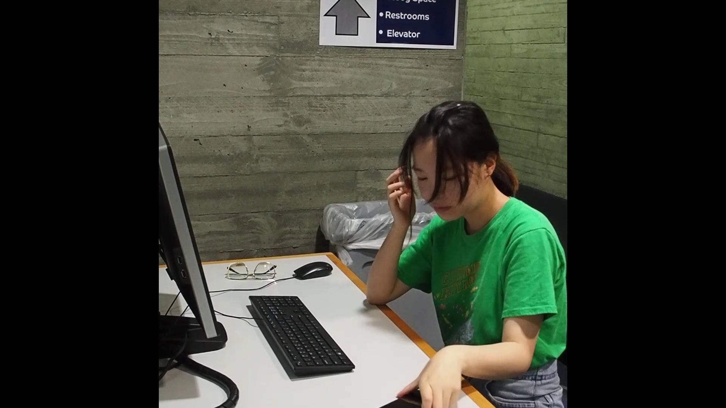
Ad
Helen whats your role?
Notes:
Prototype walk-through here

Slide 20
The Future of ReVital
Subscription Service that offers more detailed customization of plans and support from a real human
Deep Integration with more of the fitness trackers on the market to become a universal solution
Advertisement and Outreach to college students, working professionals, and global corporations which could all benefit greatly from our product
Notes:
Ian

Slide 21
Q/A
ANY QUESTIONS?

